Slide 1
Handling missing data with MICE
Neil Yetz & Gemma Wallace
01/29/2020

Slide 2
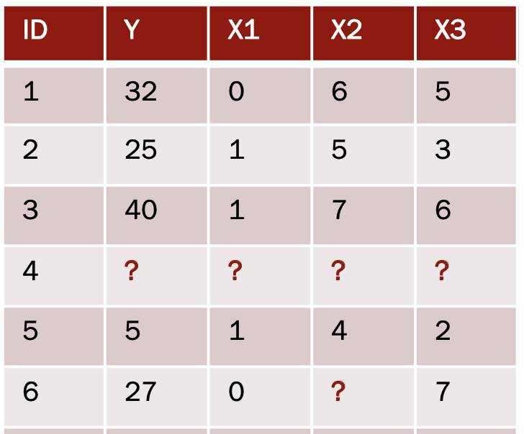
Missing data
Missing data are observations that should be part of your data but aren’t
© Kim Henry

Slide 3
Methods for handling missing data
There are several!
R uses listwise deletion by default
Can lose power and/or bias results
Multiple Imputation by Chained Equations (MICE)
Imputation = substituting missing data with estimated values

Slide 4
MICE Lab Demo
Run a simple linear regression using pairwise deletion, the default in R
Impute dataset’s missing vales using the mice package
Run a simple linear regression in the imputed data
Compare model estimates across missing data techniques

Slide 5
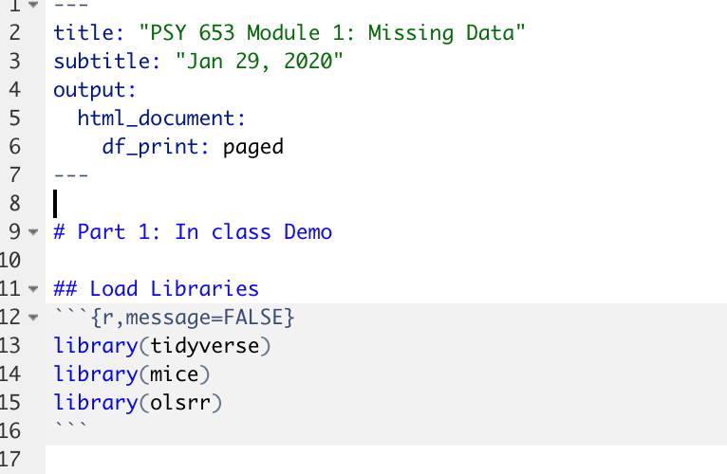
Load Libraries

Slide 6
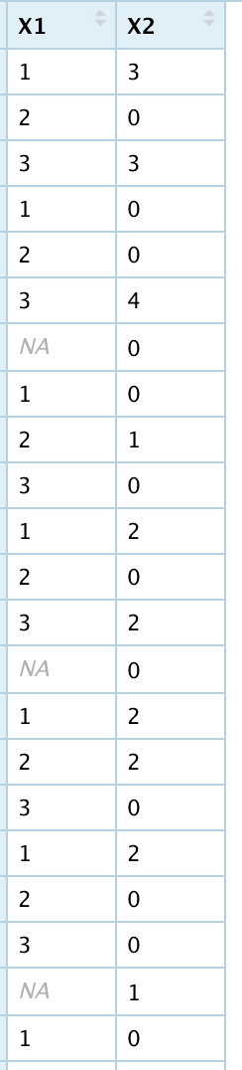
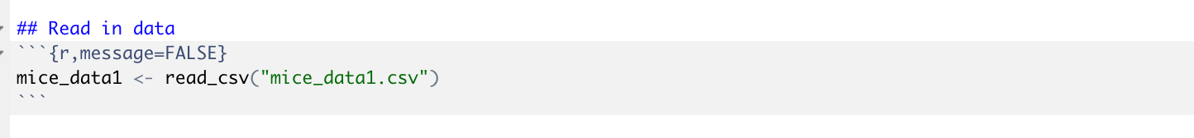
Read in data
This dataset has 2 simulated variables: X1 and X2
X1 has some missing values

Slide 7
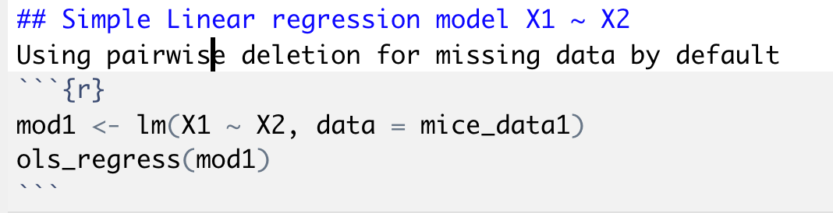
Use a Simple Linear Regression to regress X1 on X2

Slide 8
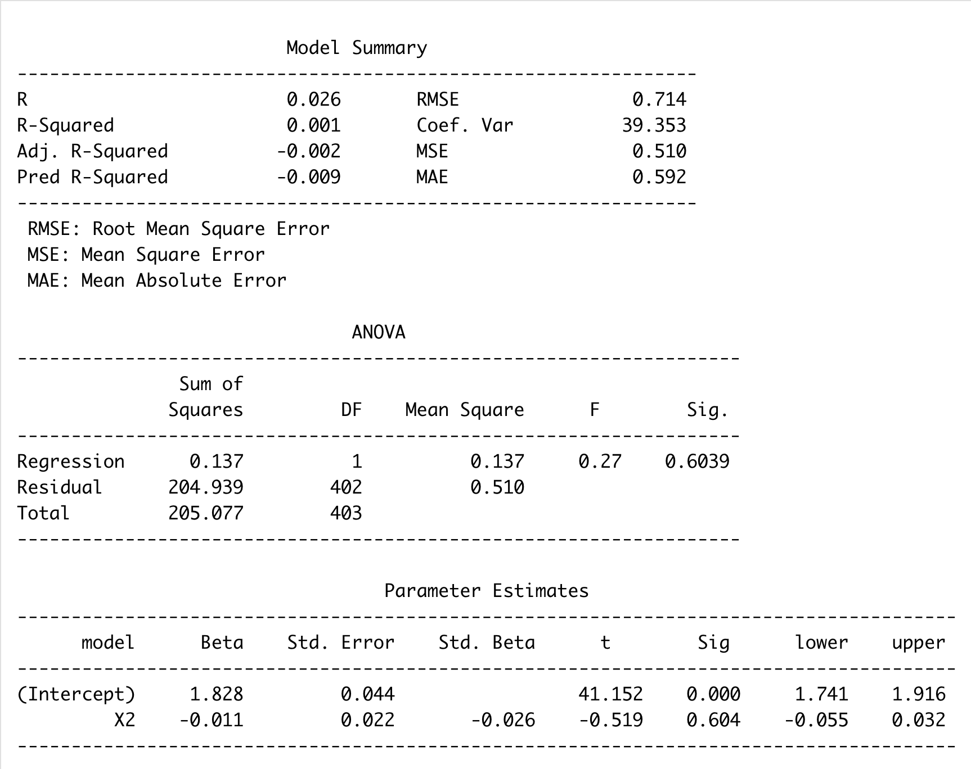
Simple linear regression output with pairwise deletion
We interpret this output as usual
In write-up, would specify “missing data
were handled using pairwise deletion”

Slide 9
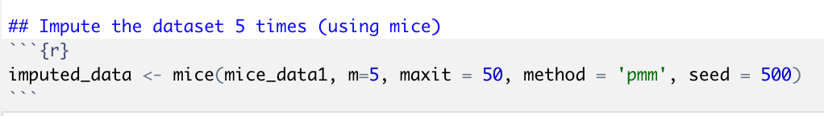
Impute the data with mice
mice_data1 = name of the dataset you are imputing
m = # of imputations (# of imputed versions of the dataset you will create)
maxit = number of iterations for each imputation (default is 5, generally do more)
method = pmm = “Predictive Mean Matching”
seed = specifying a # will allow you to get the same results each time

Slide 10
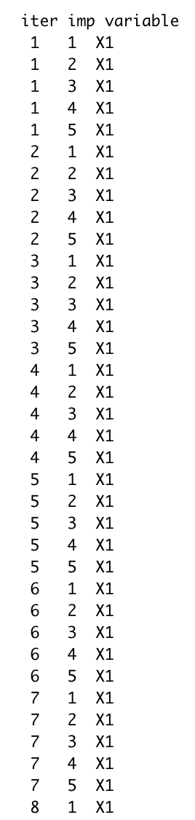
What the imputation process look like
MICE uses all of the other variables to predict each missing value

Slide 11
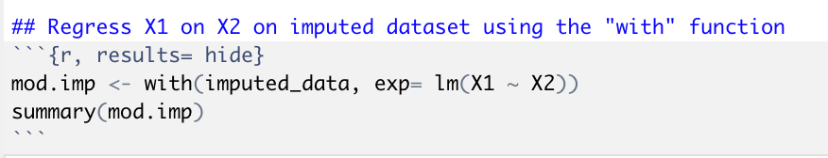
Run the same simple linear regression of X1 on X2, but this time use the imputed dataset
mod.imp = model name
with() = tells R to run the analysis in all imputations of the data
exp = an expression with a formula object
lm(X1 ~ X2) = the model you want to run. In this case, a simple linear regression
summary() = use to view model output

Slide 12
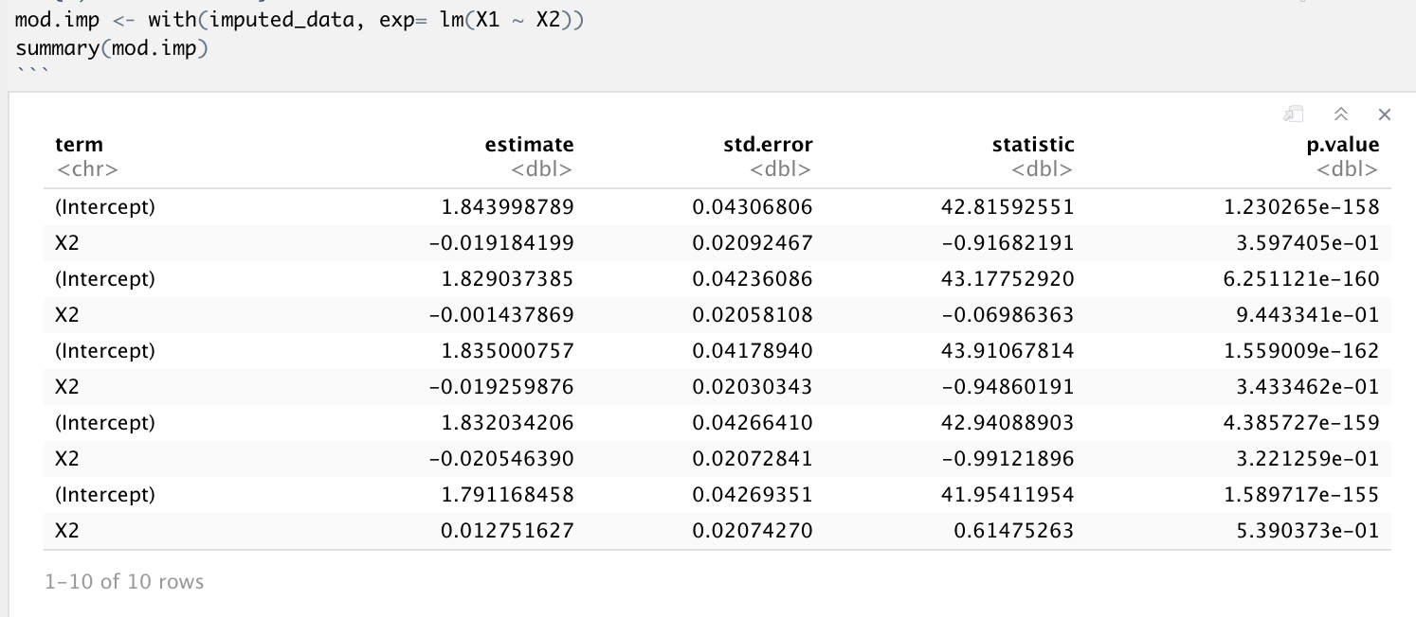
Simple linear regression output with MICE for all imputations
Imputation 1
Imputation 2
Imputation 3
Imputation 4
Imputation 5

Slide 13
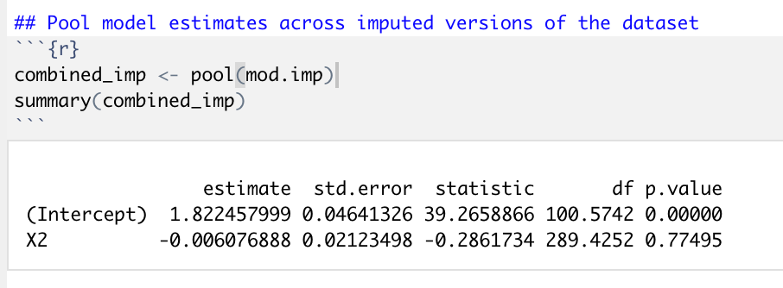
Pool model estimates from all the imputations
mod.imp = model name for SLR
pool() = tells R to combine model estimates across each imputation
summary() = use to view model output

Slide 14
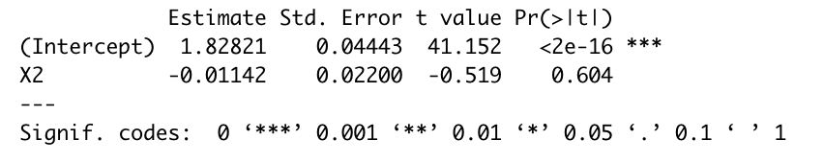
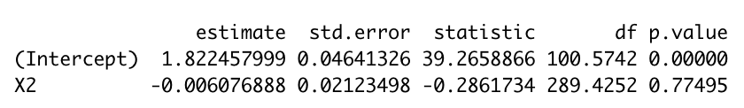
Compare model results between the missing data techniques
Pairwise Deletion:
Pooled across MICE datasets:

Slide 15
A few notes on the mice package
The with() and pool() functions allow you to pool model estimates for many common analyses
In general, you should examine missing data patterns before using mice
Can take a lot of computational power and time to run in larger datasets
Not currently compatible with machine learning and some multivariate analyses
Mplus has its own code for multiple imputation
To read more on the mice package, view the vignette here:
https://cran.r-project.org/web/packages/mice/mice.pdf

